Slide 1




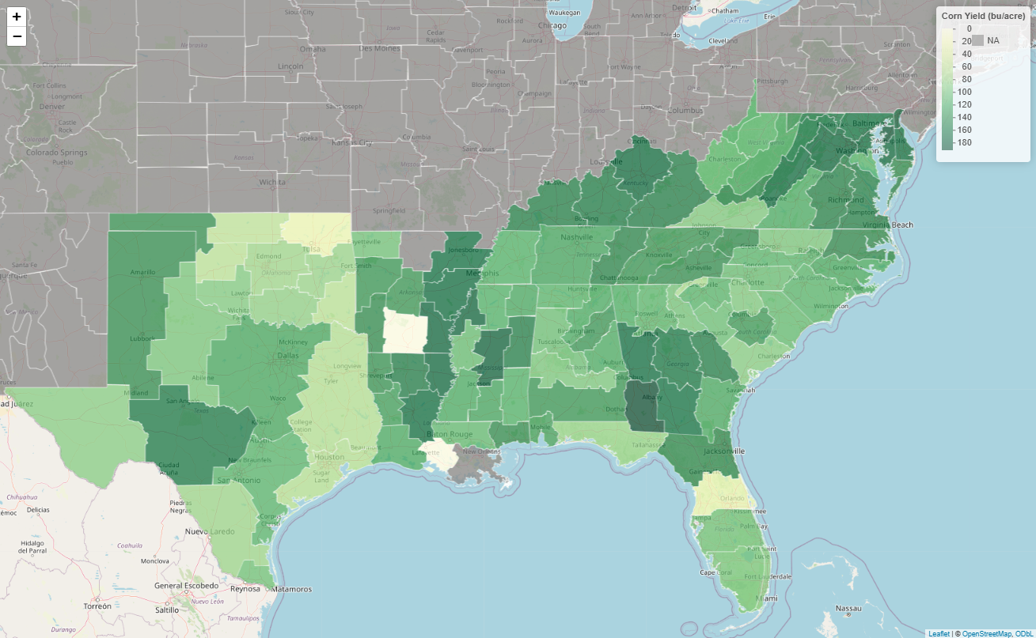
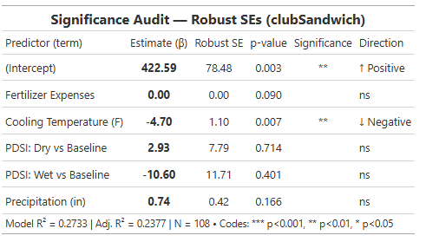
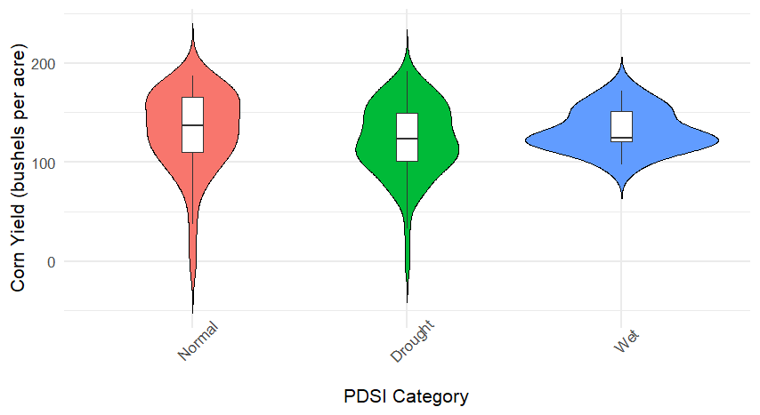
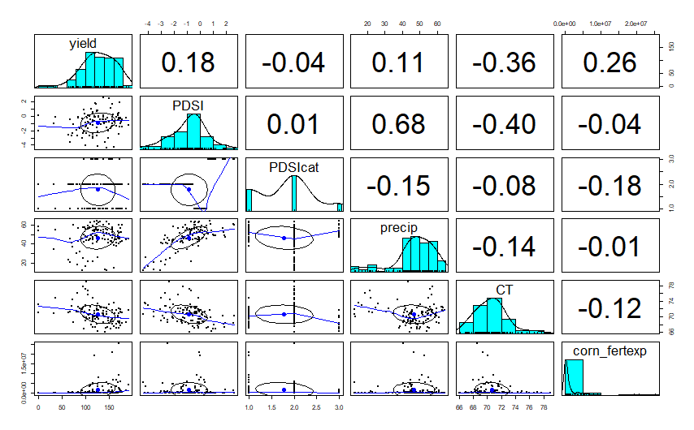
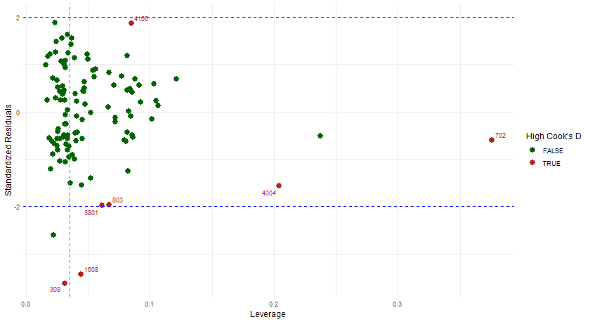
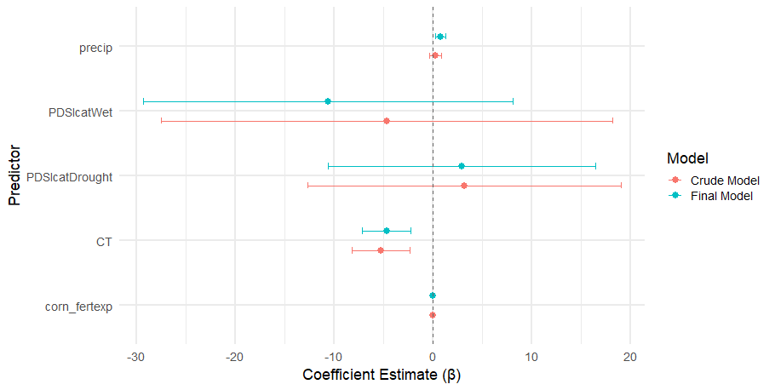
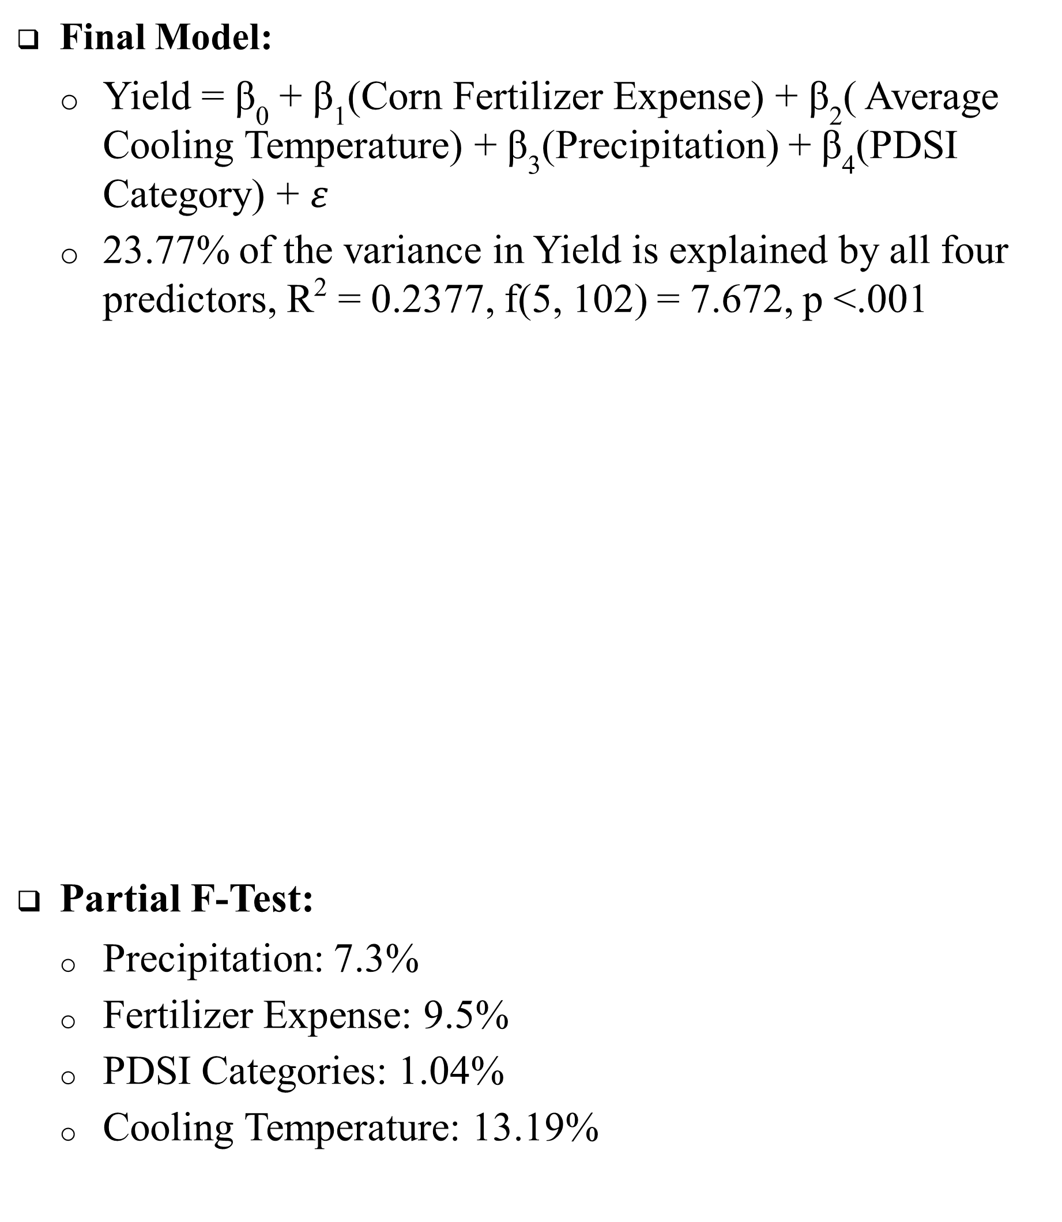
Corn in Context: Linking Meteorology, Fertilizer, and Yield Outcomes
Amanda Giddings and An Truong – Expected Graduation December 2026
Presenters Information
Introduction
Advisor: Lauren M. Matheny, Ph.D., M.P.H
Results
Background
Corn accounts for over 95% of animal feed grain and 10% of ethanol across the US
In 2019-2020, the US exported over 340,000 million metric tons of corn, leading it to be the number 1 corn exporter in the world
However, several environmental agencies have noted that corn yield has been heavily impacted by drought and heavy precipitation
Purpose
To analyze whether environmental challenges and a selected agricultural measure can predict corn yield on an annual basis
  Final Model:
    Yield = β₀ + β₁(Corn Fertilizer Expense) + β₂( Average Cooling Temperature) + β₃(Precipitation) + β₄(PDSI Category) + $ε$
    23.77% of the variance in Yield is explained by all four predictors, R² = 0.2377, f(5, 102) = 7.672, p <.001
  Partial F-Test:
    Precipitation: 7.3%
    Fertilizer Expense: 9.5%
    PDSI Categories: 1.04%
    Cooling Temperature: 13.19%
Methods
Data Wrangling:
Our dataset was combined and gathered from two main sources including United States Department of Agriculture – National Agricultural Statistics Service (USDA-NASS) and National Oceanic and Atmospheric Association – National Center for Environmental Information (NOAA-NCEI)
Non-disclosed values, notated by (D), were removed
Data Mapping: 1,423 Counties → 114 Climate Divisions across 16 states including Alabama, Arkansas, Delaware, Florida, Georgia, Kentucky, Louisiana, Maryland, Mississippi, North Carolina, Oklahoma, South Carolina, Tennessee, Texas, Virginia, and West Virginia
Statistical Analysis:
Power Analysis
A Power Analysis was assessed to determine the number of predictors that could be placed in the model without producing Type II error, based on available sample size
Exploratory Data Analysis
EDA was performed to assess data quality and variable relationships
Multiple Linear Regression Analysis
Six multiple linear regression models were assessed. The best model, based on R², applied to the analysis
Model: Yield ~ Corn Fertilizer Expense + Average Cooling Temperature + Palmer Drought Severity Index Category + Precipitation
Cook’s D, DFBetas, DFFits, Studentized Residuals were evaluated to check outliers, leverage, and influential observations
  Removed Climate Division IDs: 308, 1608, 3801, 4106, 4004, and 803
Assumption Check : Normality, Linearity, Homoscedasticity
  Supported after outliers and influential treatment
Cluster-Robust Variance Estimation (clubSandwich package) was applied, using CR2 estimator, to solve for clustering observations
Multicollinearity was checked by assessing VIF
  All predictors have VIF < 2
Partial F-Test was examined to determine if a predictor variable significantly improved the regression model
Figure 1: Corn Yield Map per Climate Division Across South US States
Conclusion
The implemented clubSandwich CR2 estimator provides reasonable bias-reduced cluster-robust variance estimator suited for datasets with small number of clusters
In the future, it may be best to consider other crops instead of focusing on a singular one
This model could be utilized regionally for crops produced in a specific geographical area
This analysis may be more beneficial if it could be run as a time series model to see whether the specific growing season is affected by these variables rather than the entire year
Overall, both precipitation and cooling temperature can be used to predict ~23% of corn yield on an annual basis
Figure 2: Violin Plot of PDSI Categories
Figure 3: Correlation Matrix Plot of Main Variables
Limitations
Data Format/Availability: During the data collection process, most of the available climate datasets were in Geographic Information System (GIS) or graphical formats, or the datasets available had limited information by county level. Additionally, many of these climate variables involved temporal components that are better suited for time-series or longitudinal analyses.
Statistical Methods: Our current model contains clusters that would be more appropriately analyzed using a multimodal regression approach. However, we have not yet had the opportunity to learn or apply this method.
Figure 4: Studentized Residuals vs. Leverage
Figure 5: Coefficient Plot of Crude vs. Updated Model
Notes:
We first gathered our data from a few different sources, primarily from the national weather thing and from the national farm thing. These two sites provided us with several different datasets. We began with:
17 variables
1, 423 counties
114 climate divisions
Each state had 3-9 climate divisions which acted as our ID level for our data
We then ran our tests of regression and determined if we had any significant outliers in our production specifically– and we did have 8 that we determined were influential and then removed. From there, we ended up transforming our data to test whether our tests were significant.
5 different linear models
List of types
4 BP tests for each independent variable used for our final analysis
clubSandwich package for clustering
For our data, we were working with more limited knowledge than some of our peers. We were not able to determine whether there was a relationship between our corn yield and time – as that bleeds into more longitudinal analyses than just regression. There was also an extensive amount of work that we had to do to make our data work as well. It was difficult determining what would be best for the corn dataset and determining which factors may be the most influential. Our initial plan was to
There were plenty of factors that may have played into the issues that we had in our model but more importantly were two items: 1) time and 2) lack of reporting of corn production at the county level. We found that some counties were not as open with their data as other and therefore it made our calculations more difficult/ Due to this, we did find some skews that would occur in our raw data such as in Figure 3 and that led to needing further correction later.
The implemented clubSandwich CR2 estimator provides reasonable bias-reduced cluster-robust variance estimator suited for datasets with small number of clusters
In the future, it may be best to consider other crops instead of focusing on a singular one
This model could be utilized regionally for crops produced in a specific geographical area
This analysis may be more beneficial if it could be run as a time series model to see whether the specific growing season is affected by these variables rather than the entire year

